Slide 1

CMOS VLSI Design Topic Memory
By
Dr.Rohit Lorenzo
Assistant Professor Sr. Grade -1
School of Electronics Engineering (SENSE)

Slide 2
Topic – Semiconductor Memories Talk Outline
Introduction
Memory Characteristics
Memory Classification
Memory Array Organization
Summary

Slide 3
Introduction
Semiconductor memory arrays capable of storing large quantities of digital information are essential to all digital systems.
The amount of memory required in a particular system depends on the type of application, but, in general, the number of transistors utilized for the information (data) storage function is much larger than the number of transistors used in logic operations and for other purposes.
The ever-increasing demand for larger data storage capacity has driven the fabrication technology and memory development towards more compact design rules and, consequently, toward higher data storage densities.
Thus, the maximum realizable data storage capacity of single-chip semiconductor memory arrays approximately doubles every two years.

Slide 4
Memory Characteristics
Area, Speed and Power
Area : The area efficiency of the memory array, i.e., the number of stored data bits per unit area, is one of the key design criteria that determine the overall storage capacity and, hence, the memory cost per bit.
Speed : Another important issue is the memory access time, i.e., the time required to store and/or retrieve a particular data bit in the memory array. The access time determines the memory speed, which is an important performance criterion of the memory array.
Power Consumption : power consumption of the memory array is a significant factor to be considered in the design, because of the increasing importance of low-power applications.

Slide 5
Memory Classification
Basic Operation Mode:
Read–Write : SRAM, DRAM, EPROM, EEPROM and Flash.
Read Only : Mask Programmable ROM.
Data Storage Mode:
Volatile : SRAM and DRAM.
Non-Volatile : Read-Write : EPROM, EEPROM and Flash.
Read Only : Mask Programmable ROM.
Access Method:
Random : ROM, SRAM, DRAM, EPROM, EEPROM and Flash.
Non-Random : SAM & CAM

Slide 6
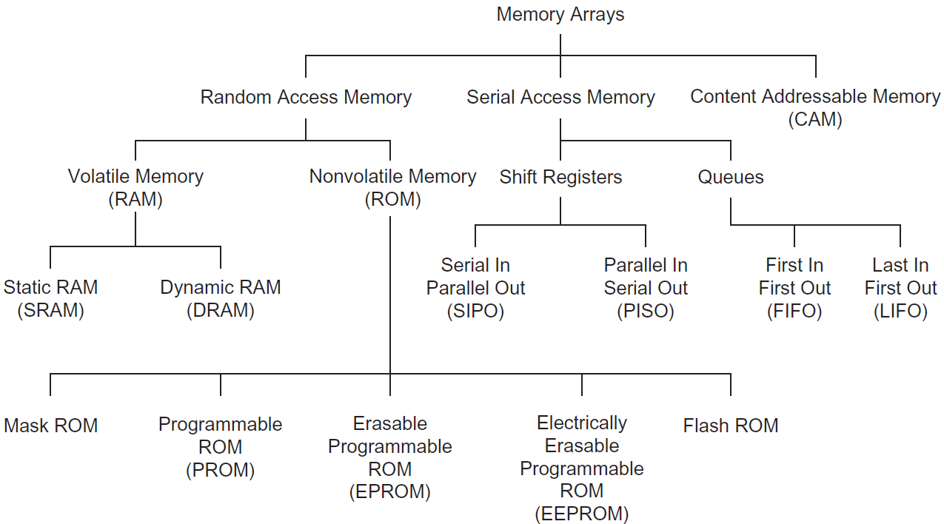
Categories of memory arrays

Slide 7
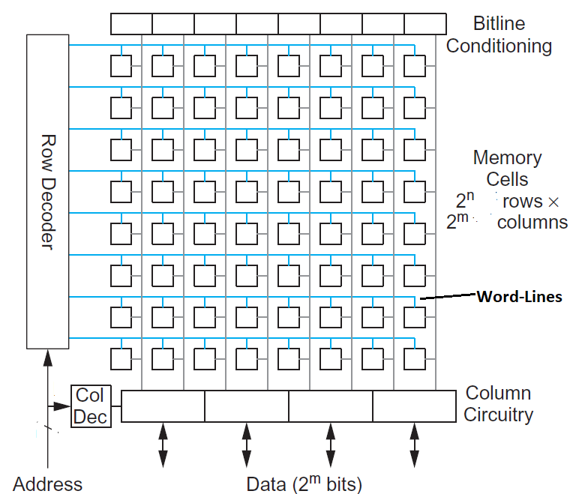
Memory Array Organization
The data storage structure, or core, consists of
individual memory cells arranged in an array of
horizontal rows and vertical columns. Each cell is
capable of storing one bit of binary information.
Each memory cell shares a common connection
with the other cells in the same row, and another
common connection with the other cells in the
same column.
In this structure, there are 2^{N} rows, also called
word lines, and 2^{M} columns, also called bit lines.

Slide 8
Continue…..
Thus, the total number of memory cells in this array is 2^{M} × 2^{N} .To access a particular memory cell, i.e., a particular data bit in this array, the corresponding bit line and the corresponding word line must be activated. The row and column selection operations are accomplished by row and column decoders, respectively.
The row decoder circuit selects one out of 2^{N} word lines according to an Nbit row address, while the column decoder circuit selects one out of 2^{M} bit lines according to an M-bit column address.
Once a memory cell or a group of memory cells are selected in this fashion, a data read and/or a data write operation may be performed on the selected single bit or multiple bits on a particular row. The column decoder circuit serves the double duties of selecting the particular columns and routing the corresponding data content in a selected row to the output.

Slide 9
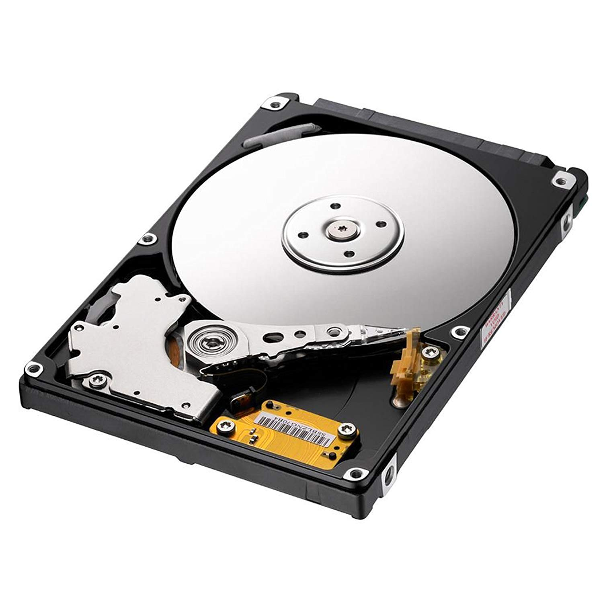
Role and Importance of different memory in System
Hard Disk Drive (HDD) - Typical rotation speed 5400 or 7200 rpm

Slide 10
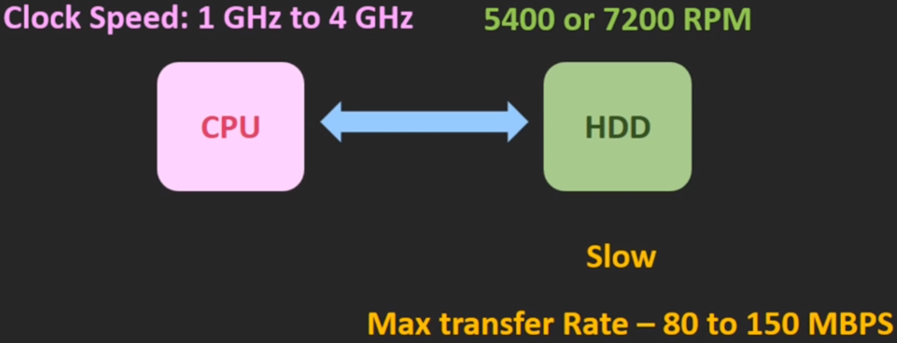
Continued…
Rohit Lorenzo, VIT-AP

Slide 11
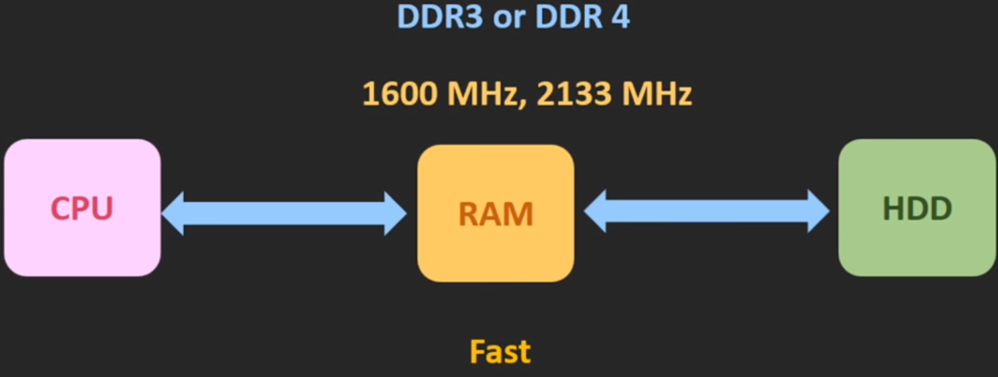
Continued…
Rohit Lorenzo, VIT-AP

Slide 12
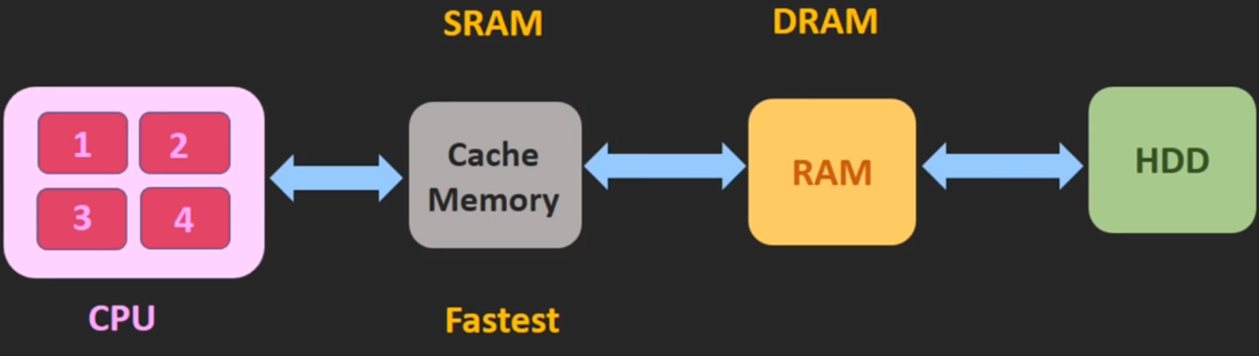
Continued…
Rohit Lorenzo, VIT-AP

Slide 13
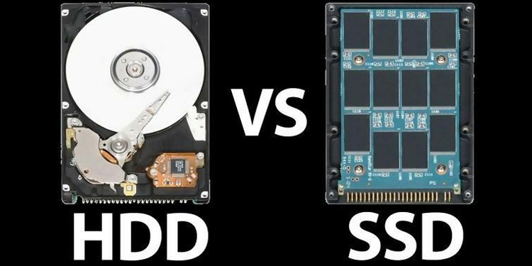
HDD Vs SSD
Rohit Lorenzo, VIT-AP

Slide 14
HDD and SSD Comparison
HDD | SSD
Average power Consumed 6 to 7 Watt | Average power consumed 2 to 3 Watt
Less cost | More cost
Average boot up-time 30-40 seconds | Boot-up time 10-13 sec
It produce more heat because of more power consumption and moving part. | It produce less heat
50 MB/s to 120 MB/s Speed | Speed 200 MB/s to 550 MB/s
Rohit Lorenzo, VIT-AP

Slide 15
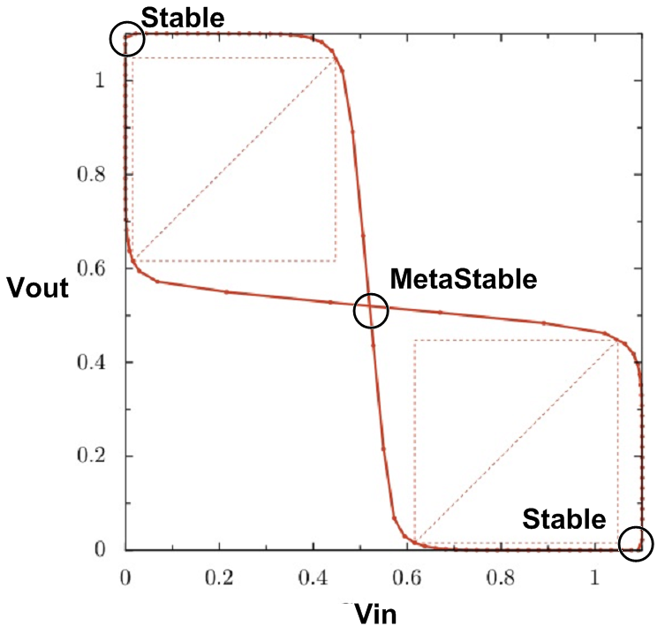
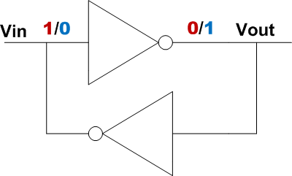
SRAM – Bi-stable Element
The basic structure of SRAM consist of two inverters are connected back-to-back to store information in SRAM Cell.
Whatever the input is given it will retain as long as the power supply is given. So this is the perfectly stable configuration.
Rohit Lorenzo, VIT-AP

Slide 16
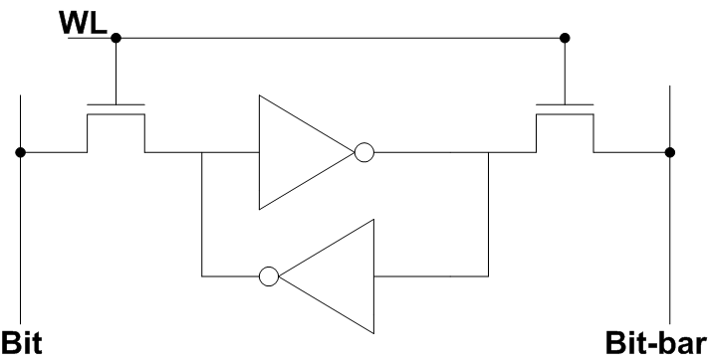
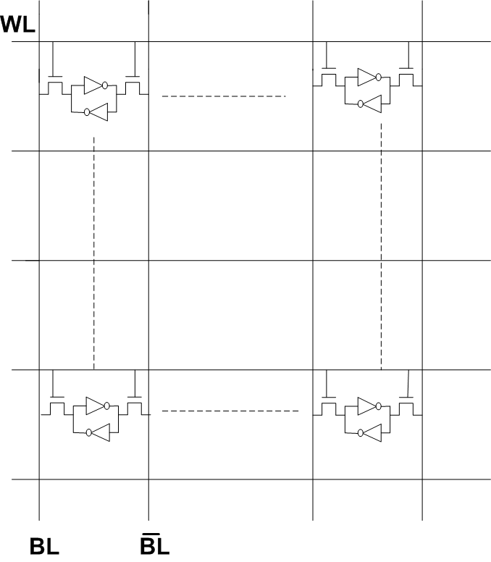
Continued…
In order to access the cell two switches are required.
These switches are called access transistors and activated by word line.
If the word line is high, the information available on Bit and Bit-bar line.
For Read and Write operation , one particular column is energize.
Sense amplifier is needed to sense the bit and bit bar lines.
Rohit Lorenzo, VIT-AP

Slide 17
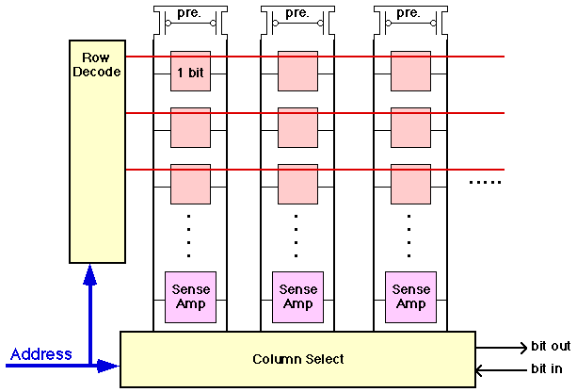
SRAM Array
Array Organization
common bit precharge lines
need sense amplifier
Rohit Lorenzo, VIT-AP

Slide 18
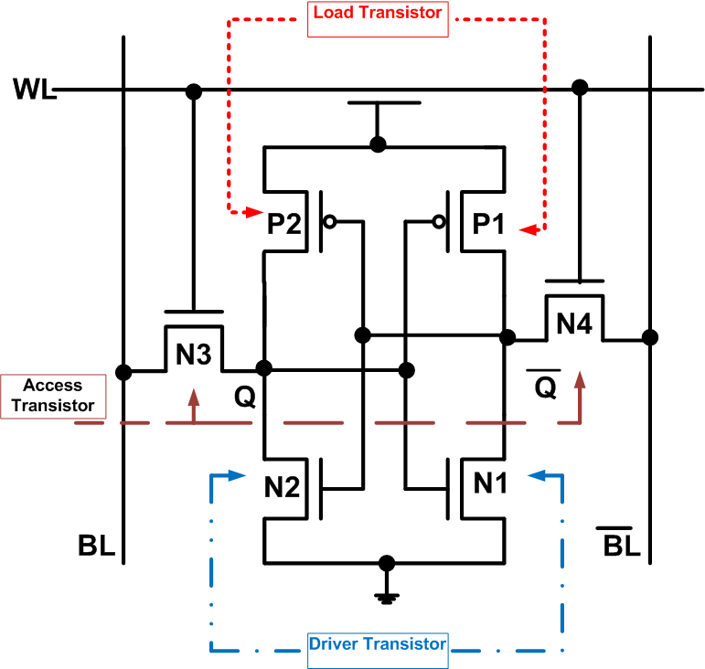
How the device Works
An SRAM cell has three different states.
1) Standby (the circuit is idle)
2) Reading (the data has been requested)
3) Writing (updating the contents)
Rohit Lorenzo, VIT-AP

Slide 19
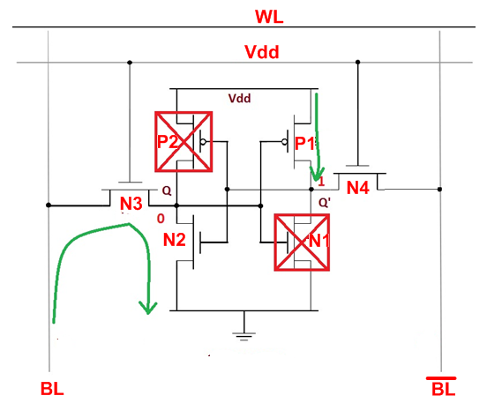
SRAM Read
Pre-charge both the Bit-lines.
Then turn-on word lines.
One of the bit-line will be pulled down
by the cell.
Rohit Lorenzo, VIT-AP

Slide 20
SRAM Write
Drive one bitline high, the other low.
Then turn on wordline.
Bitlines overpower cell with new value.
Rohit Lorenzo, VIT-AP

Slide 21
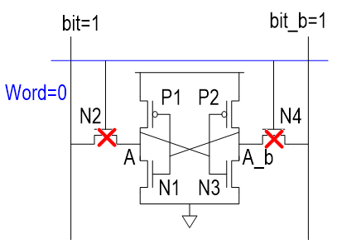
SRAM Standby Mode (Hold Mode)
The hold state of the cell occurs with the Word line is connected to ‘0’ , Which
means N2 and N4 being driven low.
The cell is disconnected in this mode.
Rohit Lorenzo, VIT-AP

Slide 22
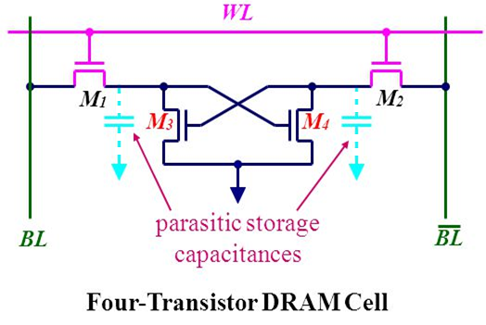

DRAM (Dynamic RAM)
Store their contents as charge on a capacitor rather than in a feedback loop.
In the quest of smaller chips area, four transistors DRAM chips emerged.
Moreover, dynamic RAMs lose information even when power is not turned OFF.
Gate capacitances store information.
To retain information the cells must be refreshed
periodically.
There is marginal area advantage over six transistor
static RAM.

Slide 23
3T – DRAM
The three-transistor DRAM cell was the first widely used dynamic
memory cell.
It utilizes a single transistor as the storage device (where the transistor is
Turned on or off depending on the charge stored on its gate capacitance),
and one transistor each for the "read" and "write" access switches.
The cell has two control and two I/O lines. Its separate read and write select
lines make it relatively fast, but the four lines with their additional contacts tend to increase the cell area.

Slide 24
2T and 1T DRAM Cell
Two transistor SRAM cell is essentially a extension of
4T SRAM cell.
As the capacitors are to be fabricated explicitly,
there is no significant area advantage over 3T or 4T.
A significant improvement in the DRAM evolution was to
switch to 1-T DRAM.
One storage capacitor is explicitly fabricated for storage purpose.
To store ‘1’ it is charged to Vdd-Vt and to store ‘0’ it is discharged 0V.
Read operation is destructive.
Read operation followed by restoration operation operation.
Occupy small chip area (capacity is more).
Process technology not compatible with CMOS (OFF chip).

Slide 25
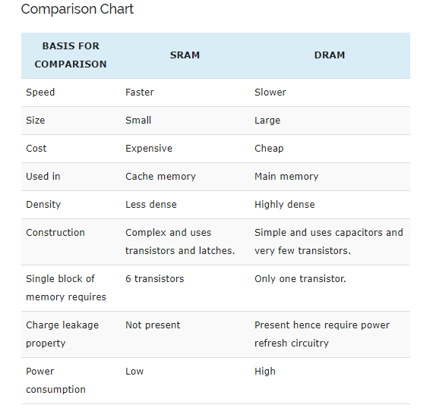
Difference between DRAM and SRAM

Slide 26
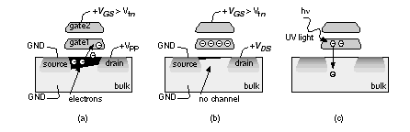
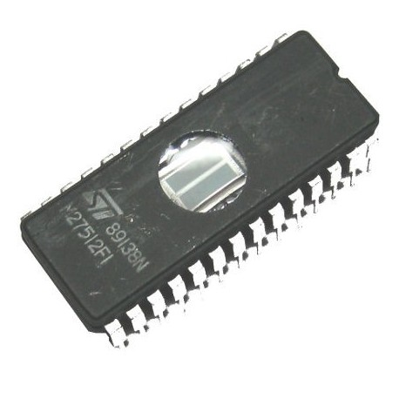
EPROM(Erasable Programmable ROM)
EPROMS combines the non-volatile property of mask programmable
ROM and read/write property of RAM.
A special type of transistor known as floating gate avalanche
injection MOS (FAMOS) is used.
This transistor has an adjustable threshold voltage that can
be electrically changed.
Floating gate realized using a double poly process , is used to
store information.
Programming is done using hot electron injection.
Erasing is done by exposing to UV lights.

Slide 27
EEPROM(Electrically Erasable Programmable ROM)
Programming can be done using one of the two techniques:
1) Hot electron injection
2) Fowler Nordheim tunnelling
Erasing is done using fowler nordheim tunnelling.
Floating gate tunnelling oxide transistor (FLOTOX)

Slide 28
Programmable Logic Device
The programmable logic device or PLD is one kind of chip used to implement the logic circuit. It includes a set of logic circuit elements that can be modified in several ways.
A PLD is looked like a black box that consists of programmable switches as well as logic gates.
Types of PLD
Programmable Array Logic(PAL) and Programmable Logic Array(PLA) are types of PLDs

Slide 29
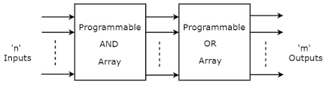
Programmable Logic Array(PLA)
The designing of the programmable logic array can be done with programmable OR gates as well as programmable AND gates. By using this we can implement two easy functions wherever the associates AND gates with each OR gate denote the highest number of product conditions that can be produced in the form of SOP (sum of product) of an exact function

Slide 30
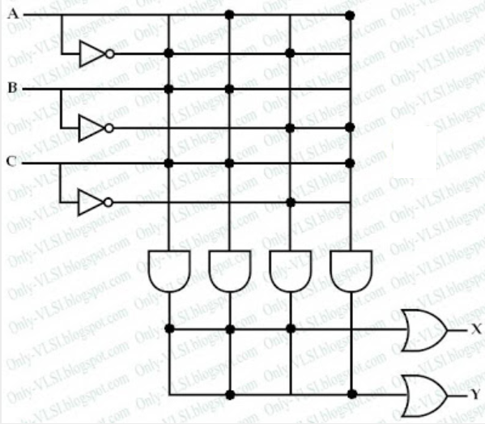
Problem
Implement following Boolean expression using PLA.
X = A'BC + ABC + A'B'C'
Y = ABC + AB'C

Slide 31
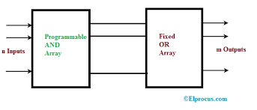
Programmable Array Logic (PAL)
The designing of the programmable array logic can be done with fixed OR gates as well as programmable AND gates

Slide 32
Thank You

